Slide 1
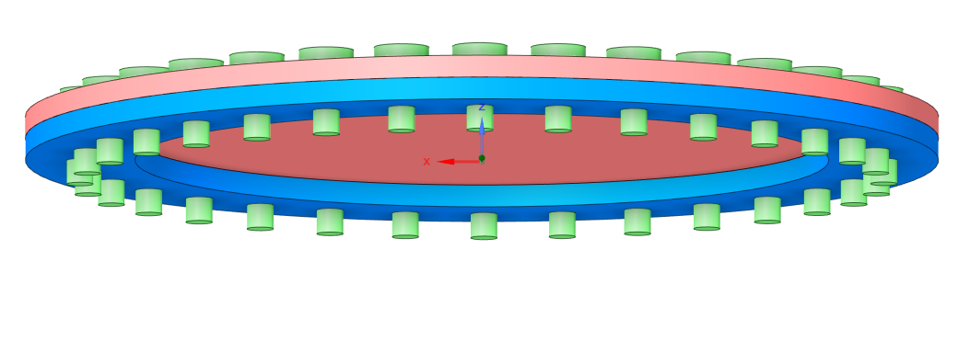
Analysis of Preload in Bolted Joints under Impulse Albert Dusseault | Advisor: Mehrdaad Ghorashi | University of Southern Maine, Engineering Department
Abstract
From transportation to storage to construction, bolted joints are utilized everywhere. Bolted joints in closures such as pressure vessels/tanks require a preload, or a specific amount of tightening of the bolts to seal the vessel when pressurized to avoid leaking. Low preload can result in joint loosening whereas high preload can result in yielding. Therefore, finding feasible and even better optimal values of preload is of great practical importance. In an earlier work in 1996, this problem was tackled with an exponentially decaying pressure applied on a pressure vessel closure. In the present analysis, however, the pressure variation is considered to be an impulse forcing function that is equivalent to the original exponential decaying pressure function. The final aim is to find conservative and optimal preload values for bolted joints of the pressure vessel closure under these conditions. Minimizing bolt elongation and stresses can result in a higher safety factor for a machine or vessel since the fasteners are at higher risk of failure. The problem has been tackled both analytically and by using simulation software. The bolt preload results are compared with those from the 1996 paper and with the ones recommended in practice.
Methods
Generate theoretical calculations with computational solver (MATLAB)
Theoretical verification for exponential decay & developing a model for evaluating response due to impulse forcing function
Use Computer-aided Design (CAD) to verify answer
ANSYS Mechanical was used for single bolt & 32 bolt designs
Major underlying equation:
$$−K_{b}\left(x−x_{b}\right)−K_{m}\left(x−x_{m}\right)−\left(C_{m}+C_{b}\right)\dot{x}+f\left(t\right)=M\ddot{x}$$
Figure 1. Full System Representation
Results
Calculating the theoretical deformation showed that the exponential decay had a parabolic curve resulting in an optimal prestress of 140MPa (Figure 2); whereas the impulse forcing function increased from the start, with an optimal prestress of under 100MPa (Figure 3). This alludes to the fact that the impulse force acts in such a short time that the main constraint to worry about would be yielding. CAD modeling showed unique results based on the version of modeling used (1 vs. 32 bolts). The full system model (Figure 3) was able to replicate deformation accurately, but the single bolt model showed more accurate stress distributions. Deformation on impulse vs. exponential decay was 0.17mm compared to 0.2mm on a prestress value of 200MPa on the system model. The proper stress distribution garnered from the single bolt model is shown in Figure 4.
Figure 2. Undamped Exponential Response
Background
Analyzing stress in bolted joints, especially those under a large amount of force in a very short timespan (impulse), is best looked at through the lens of vibrations. This case would be a mass-spring-damper system which utilizes a set of constants for the bolts and another set of constants for the closure mass & pressure vessel mass. Issues can arise in these systems in the form of yielding and lift-off. Most important to us is going to be the maximum deformation; which, happens at some incredibly small time after the explosion of force impacting the closure. This is where impulse comes in: impulse takes the exponential decay force curve and replicates the area within a smaller region. In short: exponential curves can last a long time before reaching zero, whereas impulse takes that area and shortens it drastically. The assembly can be seen in Figure 1, where a representative 32 bolts close a plate-like mass to the ring of a pressure vessel enclosure.
Conclusion & Next Steps
The stress distribution and deformation were agreeable between CAD and theoretical designs on both the impulse and the exponential decay verification.
The way forward would be to eventually merge the two CAD designs to be agreeable on both fronts: deformation and stress with both geometries. Ideally for the single bolt given the higher mesh element density for more accurate information gained from each study.
Figure 3. Full System Bolt Shank Deformation Maximums (Impulse)
Acknowledgements:
I’d like to thank Dr. Ghorashi for pushing me to squeeze every bit of detail out of the project that I could.
References
Bickford, J. H. (2008). Introduction to the Design and Behavior of Bolted Joints, Fourth Edition (4th ed.). Taylor & Francis.
Esmailzadeh, E., Ghorashi, M., & Ohadi, A. R. (1996). Analysis of Preloaded Bolted Joints Under Exponentially Decaying Pressure. Journal of Pressure Vessel Technology, 118(4), 393–398. https://doi.org/10.1115/1.2842204
Figure 4. Stress Distribution along a single bolt
Notes:
This is an example- rearrange/modify/completely change according to your project, your goals, your results, etc. This example is really so you can judge how large to make your fonts, and make sure you have all the “parts” in your poster. If you are creating a poster that features your art, your history project, and so on, you will find that you really need to modify/rework/eliminate this poster template.
Make sure you have a least 0.5” inch border to avoid printing problems.

