Slide 1
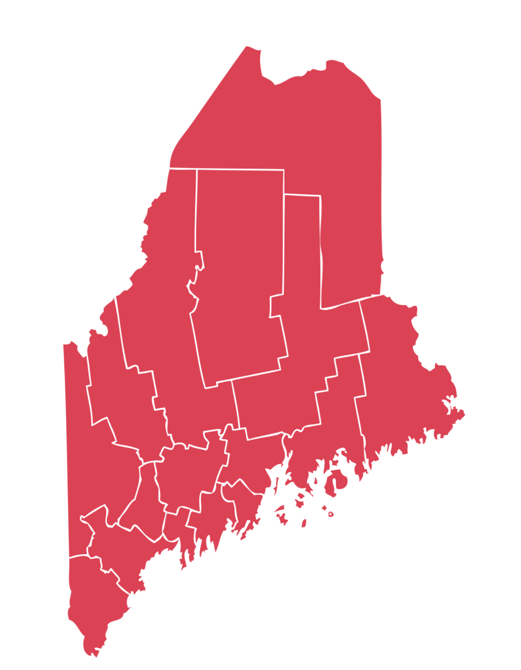
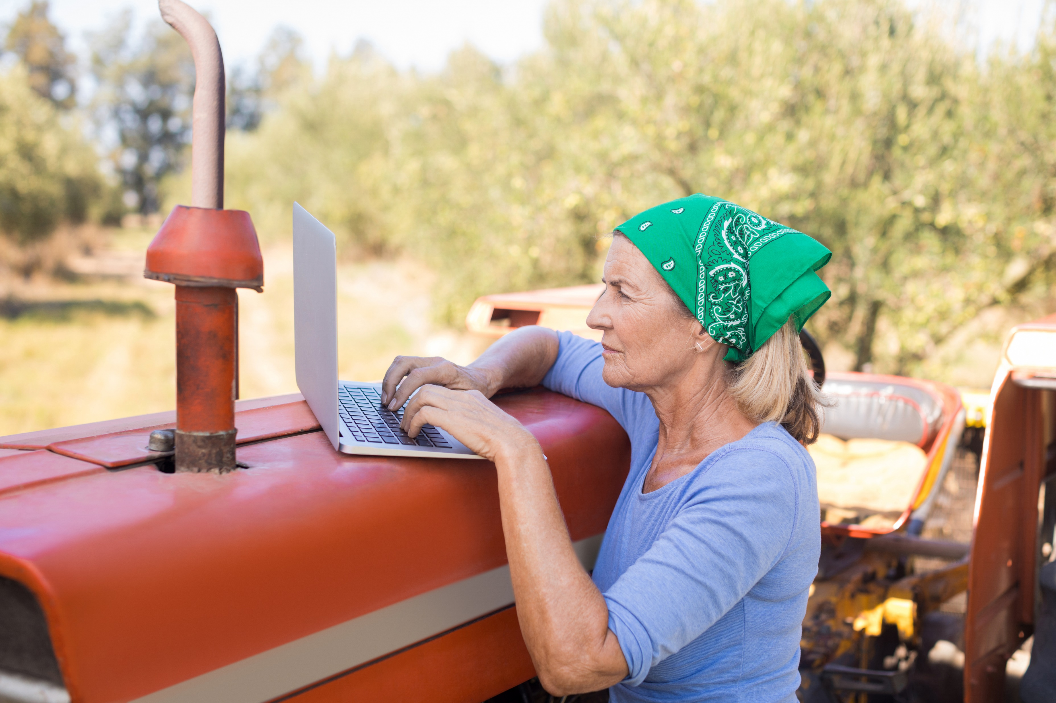
Support Needs of Rural Maine Women Entrepreneurs
Lisa Luken, MA Candidate – Leadership Studies, Dr. Elizabeth Goryunova – Leadership Studies
Abstract
Rural women entrepreneurs have the power to positively impact the sustainability of their communities, yet they are faced with internal and external challenges in their pursuits to grow successful businesses and create sustainable livelihoods. While a number of scholars in the past 10 years investigated these challenges and suggested some solutions, more research is needed to identify additional solutions, including those specifically relevant to rural Maine communities.
This qualitative study explored the support women entrepreneurs in rural Maine need from each other and their communities to thrive. Data gathered through semi-structured interviews with 11 women entrepreneurs from rural Maine revealed four overarching themes and a shared phenomenon.
The findings contribute to the literature exploring the support needs and self-leadership of rural women entrepreneurs. Additionally, the findings can be utilized by community constituents to facilitate the development of women as leaders in growing entrepreneurial ecosystems and advancing the economic sustainability of rural communities in Maine.
Maine
Discussion
Thriving through support from fellow women entrepreneurs
In line with Eriksson & Rataj’s (2019) findings that social capital is critical for entrepreneurial growth, participants described networks and partnerships with fellow women entrepreneurs as fundamental in their ability to thrive as entrepreneurs in rural communities.
One discussed having “really awesome female business owners in [her] area…who all just really support each other” and another shared, “in my area women, especially, are more supportive of each other and are willing to share the business instead of being competitive, it's more collaborative.”
Thriving through support from community
Supporting findings from a Premier Quantitative Consulting (2019) study, participants described needing “access to resources,” back-end business guidance, and access to mentors, which they seek from their communities.
To thrive, participants stated they need “customers and people interested in what we're doing” and “social interaction,” while another stated, “community support is huge, especially around here because, again we don't have resources we just have each other….we really rely heavily on one another for a lot of things.”
Another described thriving as “facilitating a place in our community where people can come together and we can insight cross-pollination.” This aligns with previous research stating women leaders who participate in the development of their communities as business owners can stretch their impact even further (Vidickienė, 2017).
Physical environment critical to thriving
Participants also spoke of thriving through “being in nature,” “being outside and around Maine,” and having space to operate and to share their work, which supports Anderson and Noblet’s (2020) findings that highlight the desires of some to live in authentic Maine environments.
Thriving through self-leadership
Self-leadership was expressed as participants shared their experiences as entrepreneurs. To thrive, one shared she needed “really good observation skills of what's working, what's not working and willingness to pivot” and another shared that having “a certain level of control” is essential to thriving. This aligns with previous findings that self-leadership can improve entrepreneurial success (Rasdi et al., 2020).
Fig. 1. Rural-Urban Population
Source: U.S. Census Bureau (2010c)
Fig. 2. Population by Sex
Source: U.S. Census Bureau (2010a)
Results
Four major themes emerged from analysis of the interviews with the 11 women entrepreneurs in rural Maine. The four themes include: (1) personal fulfillment, (2) navigating entrepreneurship, (3) community connections, and (4) giving back.
(1) Personal fulfillment was discussed in relation to having a desirable lifestyle, engaging in enjoyable work, and being in Maine and in nature.
(2) Navigating entrepreneurship emerged as participants shared examples of exercising agency, making strategic business decisions, and working through business challenges.
(3) Community connections were illustrated through key partnerships and support networks with fellow women entrepreneurs as well as relationships with local, regional, and online communities.
(4) Giving back was conveyed as participants described their leadership approaches, which include leading from behind, by example, by giving, and by teaching, as well as the personal investments they are making in their communities.
The analysis of the women’s lived experiences as entrepreneurs in rural Maine also revealed the shared phenomenon of intentionality.
Introduction
Increasing economic development and improving entrepreneurial ecosystems have been identified as strategic development initiatives in Maine (Governor’s Office of Policy Innovation and the Future, 2020). The potential for women to influence economic development is notable in Maine, where 61 percent of the population lives in rural areas (Figure 1), and 51 percent of the population is women (Figure 2). This study is significant in that it provides insight into how to support rural women entrepreneurs in Maine.
Research Question
What support do women entrepreneurs in rural Maine need from each other and their communities to thrive?
Methods
The phenomenological methodology was used to obtain data directly from the participants about their lived experiences.
Interviews were conducted with 11 women entrepreneurs from 10 businesses in rural Maine using a series of open-ended questions.
Individuals for the study were chosen purposively through convenience sampling to ensure individuals selected met the criteria of being a woman entrepreneur (individuals identifying as a woman) operating a business in a rural community in Maine (Creswell & Creswell, 2018).
Rural towns were selected using the U.S. Census Bureau definition of rural which has a population under 2500 (U.S. Census Bureau, 2010b). The Department of Administrative and Financial Services State of Maine City and Town Population Projections 2038 report (n.d.), containing the most recent city population data at the time the samples were selected (from 2018), was used to confirm that the cities in which the businesses operate had populations under 2,500.
References
Anderson, M., & Noblet, C.L. (2020). We are Maine-Is there an authentic Maine public policy? Maine Policy Review, 29(2), 39-44. https://digitalcommons.library.umaine.edu/mpr/vol29/iss2/6
Creswell, J. W., & Creswell, J. D. (2018). Research design: Qualitative, quantitative, and mixed methods approaches. (5th ed.). SAGE Publications.
Eriksson, R. & Rataj, M. (2019). The geography of starts-ups in Sweden. The role of human capital, social capital and agglomeration. Entrepreneurship and Regional Development, 31(9-10), 735-754. https://doi.org/10.1080/08985626.2019.1565420
Governor’s Office of Policy Innovation and the Future (2020, November 24). Maine governor’s economic recovery committee: Recommendations to sustain and grow Maine’s economy. https://www.maine.gov/future/sites/maine.gov.future/files/inline-files/Maine%20ERC%20Report_FINAL_11242020.pdf
Department of Administrative and Financial Services State of Maine. (n.d.) Maine city town population projections 2038. Retrieved from https://www.maine.gov/dafs/economist/sites/maine.gov.dafs.economist/files/inline-files/MaineCityTownPopulationProjections2038.pdf
U.S. Census Bureau. (2010a). Quick facts: Maine; United States. https://www.census.gov/quickfacts/fact/table/ME,US/SEX255219
U.S. Census Bureau. (2010b). Rural America: A story map. https://mtgis-portal.geo.census.gov/arcgis/apps/MapSeries/index.html?appid=49cd4bc9c8eb444ab51218c1d5001ef6#:~:text=The%20Census%20Bureau%20defines%20rural,NOT%20in%20an%20urban%20area.
U.S. Census Bureau. (2010c). Urban and Rural Decennial Census. https://data.census.gov/cedsci/table?q=DECENNIALCD1162010.P2&g=0400000US23&tid=DECENNIALSF12010.P2&hidePreview=true
Premier Quantitative Consulting. (2019). Rural women entrepreneurs: Challenges and opportunities. National Women’s Business Council. https://www.nwbc.gov/2019/05/08/rural-women-entrepreneurs-challenges-and-opportunities/
Rasdi, R. M., Hamzah, S. R., & Yean, T. F. (2020). Exploring self-leadership development of Malaysian women entrepreneurs. Advances in Developing Human Resources, 22(2), 189–200. https://doi.org/10.1177/1523422320907048
Vidickienė, D. (2017). Attractiveness of rural areas for young, educated women in post-industrial society. Eastern European countryside, 23(1), 171-190. https://doi.org/10.1515/eec-2017-0008
Photo credit: Wavebreakmedia
Acknowledgements
Thank you to Dr. Paula Gerstenblatt, Dr. Jamie Picardy, and Dr. Paul Caron for their mentoring, review, and feedback throughout the study, as well as Clara Parka and other classmates who provided feedback through peer reviews.

