Slide 1
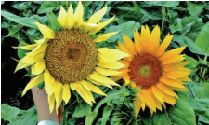
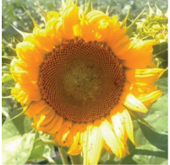
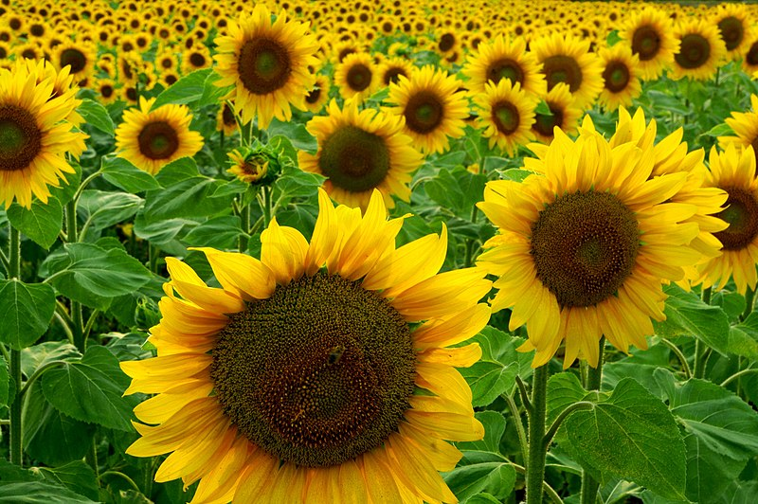
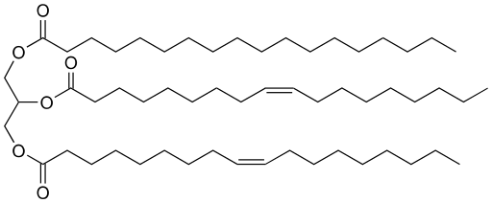
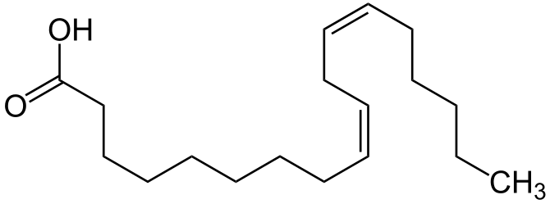
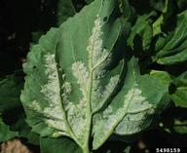
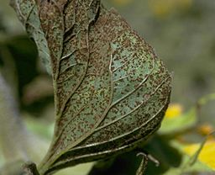
Genetic Diversity in Helianthus annuus:
Selective Breeding and Induced Mutagenesis
Dillon Holton – Southern Maine Community College
Abstract:
H. annuus, more commonly known as the sunflower, is a single species that has many different variations. Traits have been selectively bred for hundreds of years in order to produce a beautiful flower as well as essential agricultural products. Recently interest in the sunflower as a food and fuel crop has led to selective breeding of seeds that produce high yields of sunflower oil. To further push the limits of this plant's genome, researchers have used mutagenesis to force mutations in hopes of developing novel modifications that could increase yield. With the entire genome mapped, the goal for many research groups is to create new genetic starting material for selective breeding. Chemical and radiation-based mutations have been shown to not only increase yield of useful lipid molecules but also create very bizarre looking appearances. This literature review poster discusses hybrid strains, mutant strains and methods of creating new modified genes to increase yields from this staple crop.
Lipid molecules of interest
Common Triglyceride
1
2
Wild
Vitamin E (α-tocopherol)
Linoleic Acid
Discussion:
The sunflower genome is a large one, but it has been mapped. Many genes of interest have been identified across 17 different chromosomes. Research is now focused on genes influencing traits such as heavier yield per flower, greater oil content and disease resistance. It is challenging to stabilize a desirable phenotype, since the desired trait may depend on a combination of genes in loci on different chromosomes. Selective Breeding for these quantitative trait loci (QTL) is usually necessary.
The results from mutagenesis appear just as valuable as those from selective breeding and from QTL analysis. Mutagenesis can yield more novel and unexpected traits while crossing and mapping can help to refine traits that are already know to exist. The end goal of much of this research is to create an agricultural crop that can be a more efficient food and fuel resource.
3
4
5
6
7
8
Mutant Strain | Physical Features | Useful Trait | Method of Development
KhNAU742V | Modified flower/Large number of leaves | 70.54% linoleic Acid (7.79% higher than control) | Chemical Mutagen: Dimethyl Sulfoxide (DMS)
KhNAU448V | Crimson tint in leaves | 30.05% oleic Acid (3.55% higher than control) | Chemical Mutagen: DMS
KhNAU1133V | Light yellow flower petals | 70.54% linoleic Acid(7.79% higher than control) | Gamma Radiation Mutagen
KhNAU 553 | Shorter than average | 0.8% behenic acid content(0.5% higher than control) | Chemical Mutagen: DMS
MC29 | Wild Type | Sunflower Rust Resistance | Selective Breeding
HA-267 | Wild Type | Broomrape Resistance | Genomic Mapping and Quantitative trait loci (QTL) analysis
RHA 340 | Wild Type | Downy Mildew Resistance | Selective Breeding
Downy Mildew
Sunflower Rust
References:
Dimitrijevic, A., & Horn, R. (2018). Sunflower hybrid breeding: From markers to genomic selection. Frontiers in Plant Science, 8. https://doi.org/10.3389/fpls.2017.02238
Martínez-Force Enrique. (2015). Chapters 1 and 2. In Sunflower: Chemistry, production, processing, and Utilization (pp. 1–37). essay, AOCS Press.
Schwartz, H. (2013). Downy mildew(Plasmopara halstedii). IPMImages.org. Colorado State University, Bugwood.org. Retrieved April 10, 2022, from https://www.ipmimages.org/browse/detail.cfm?imgnum=5498159.
Vasko, V. O., &amp; Kyrychenko, V. V. (2019). Induced mutagenesis for the creation of new starting material in Sunflower Breeding. Helia, 42(70), 17–36. https://doi.org/10.1515/helia-2017-0024
Acknowledgements:
Prof. Daniel Moore, Southern Maine Community College Library, SMCC Genetics Class BIOL 212

